Slide 1

RealData Application
A public data science utility web-application with interactive surveys and integrated cryptocurrency
https://www.RealData.app

Slide 2
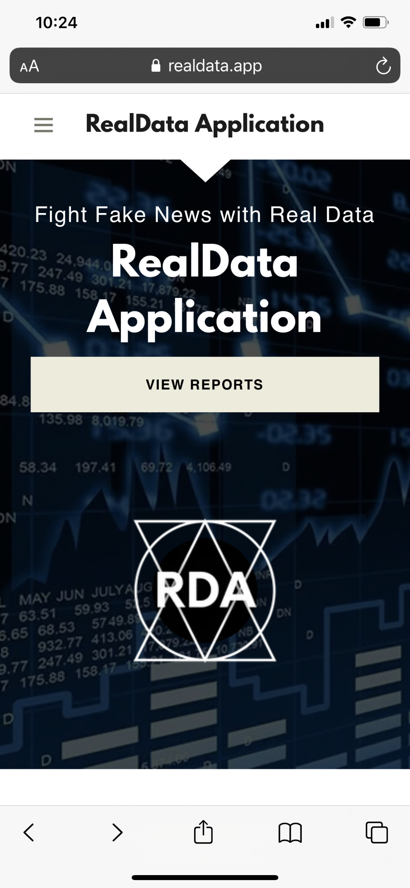
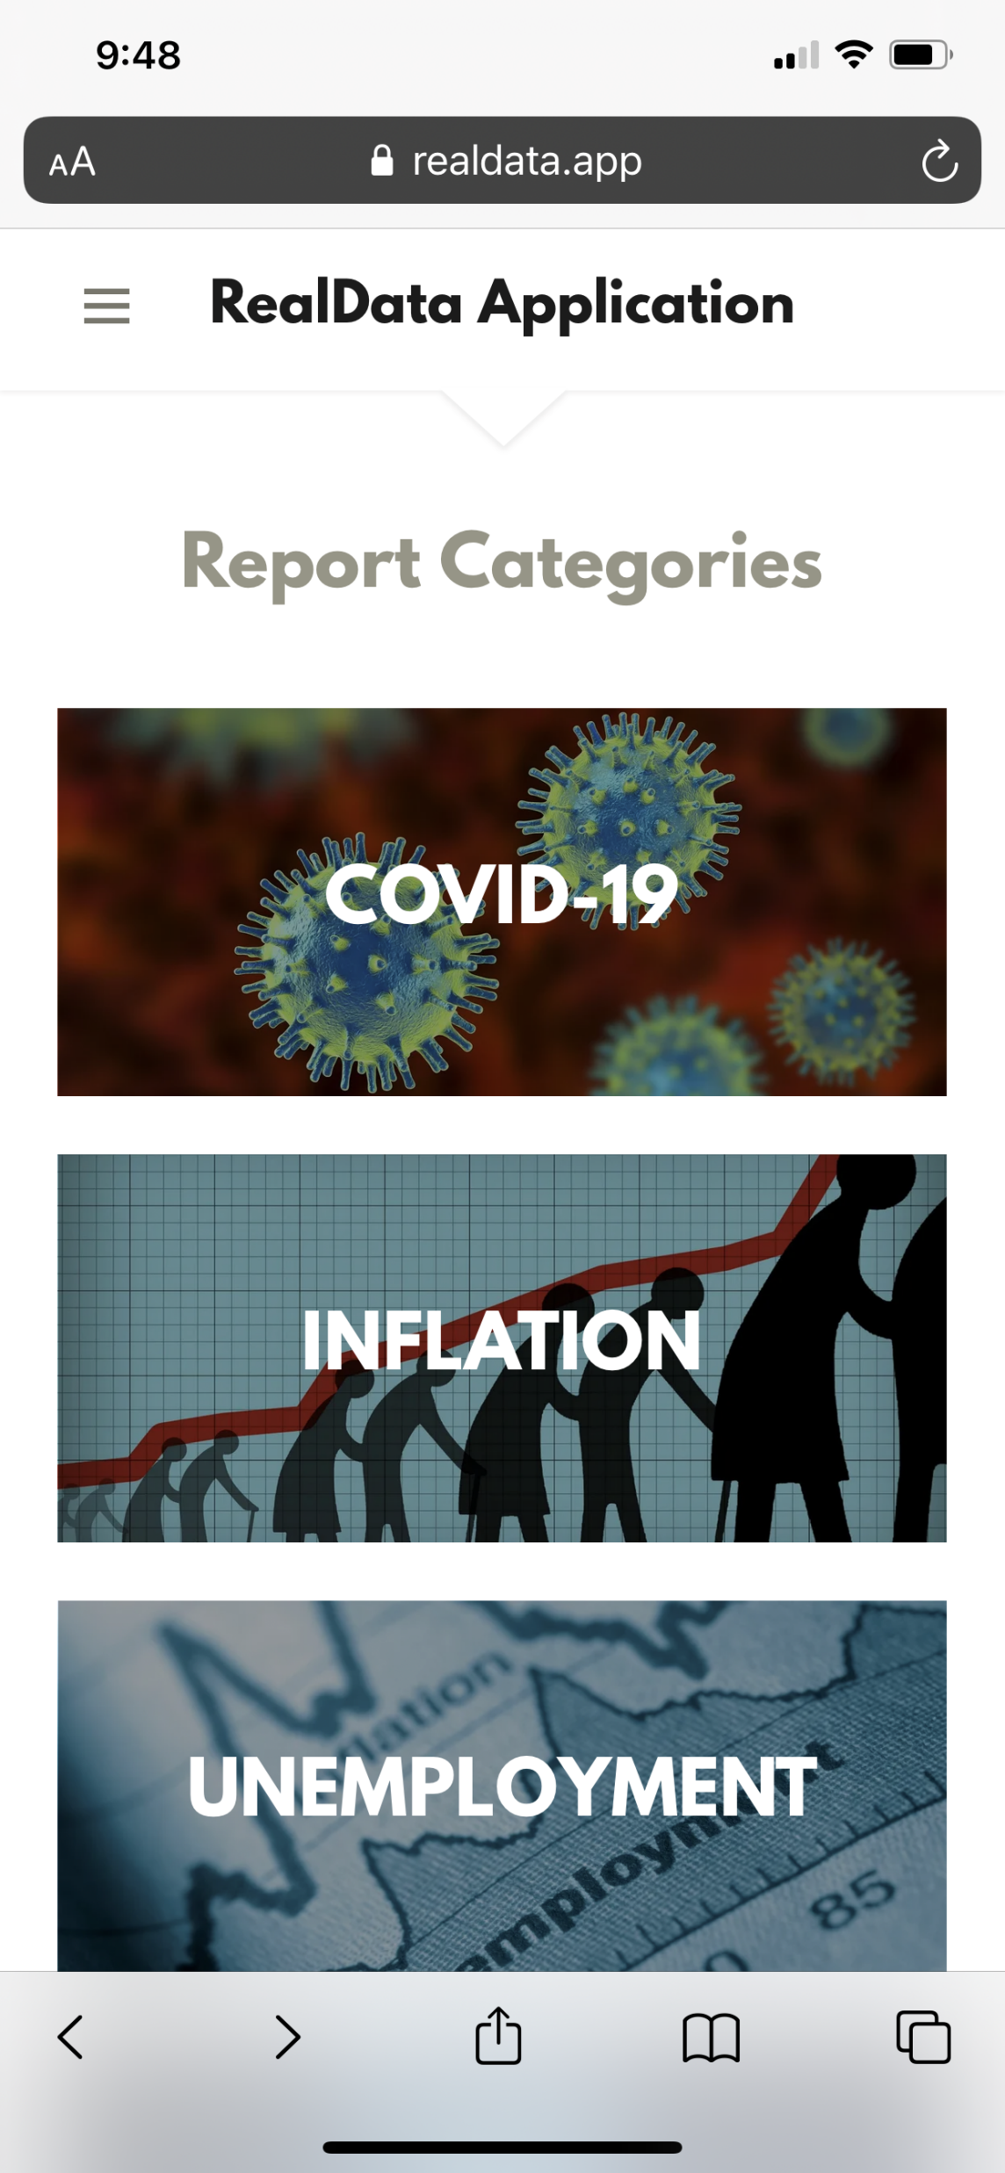
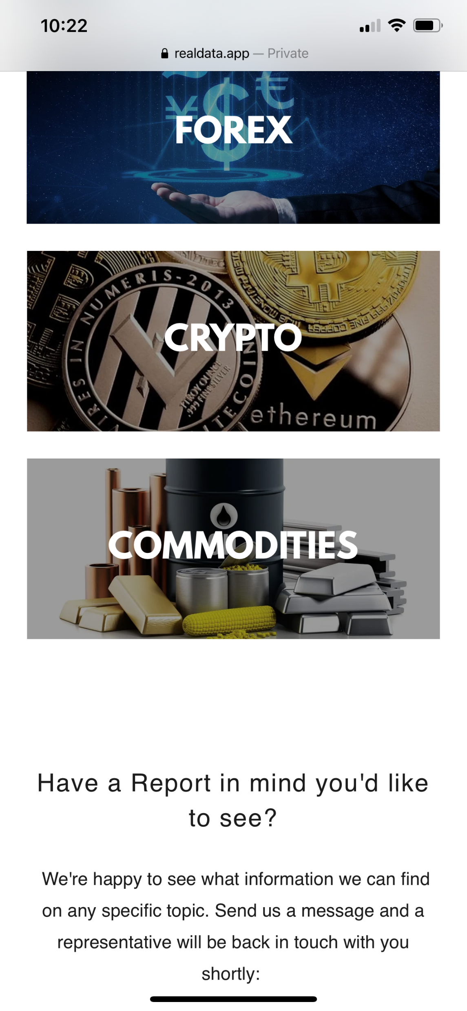
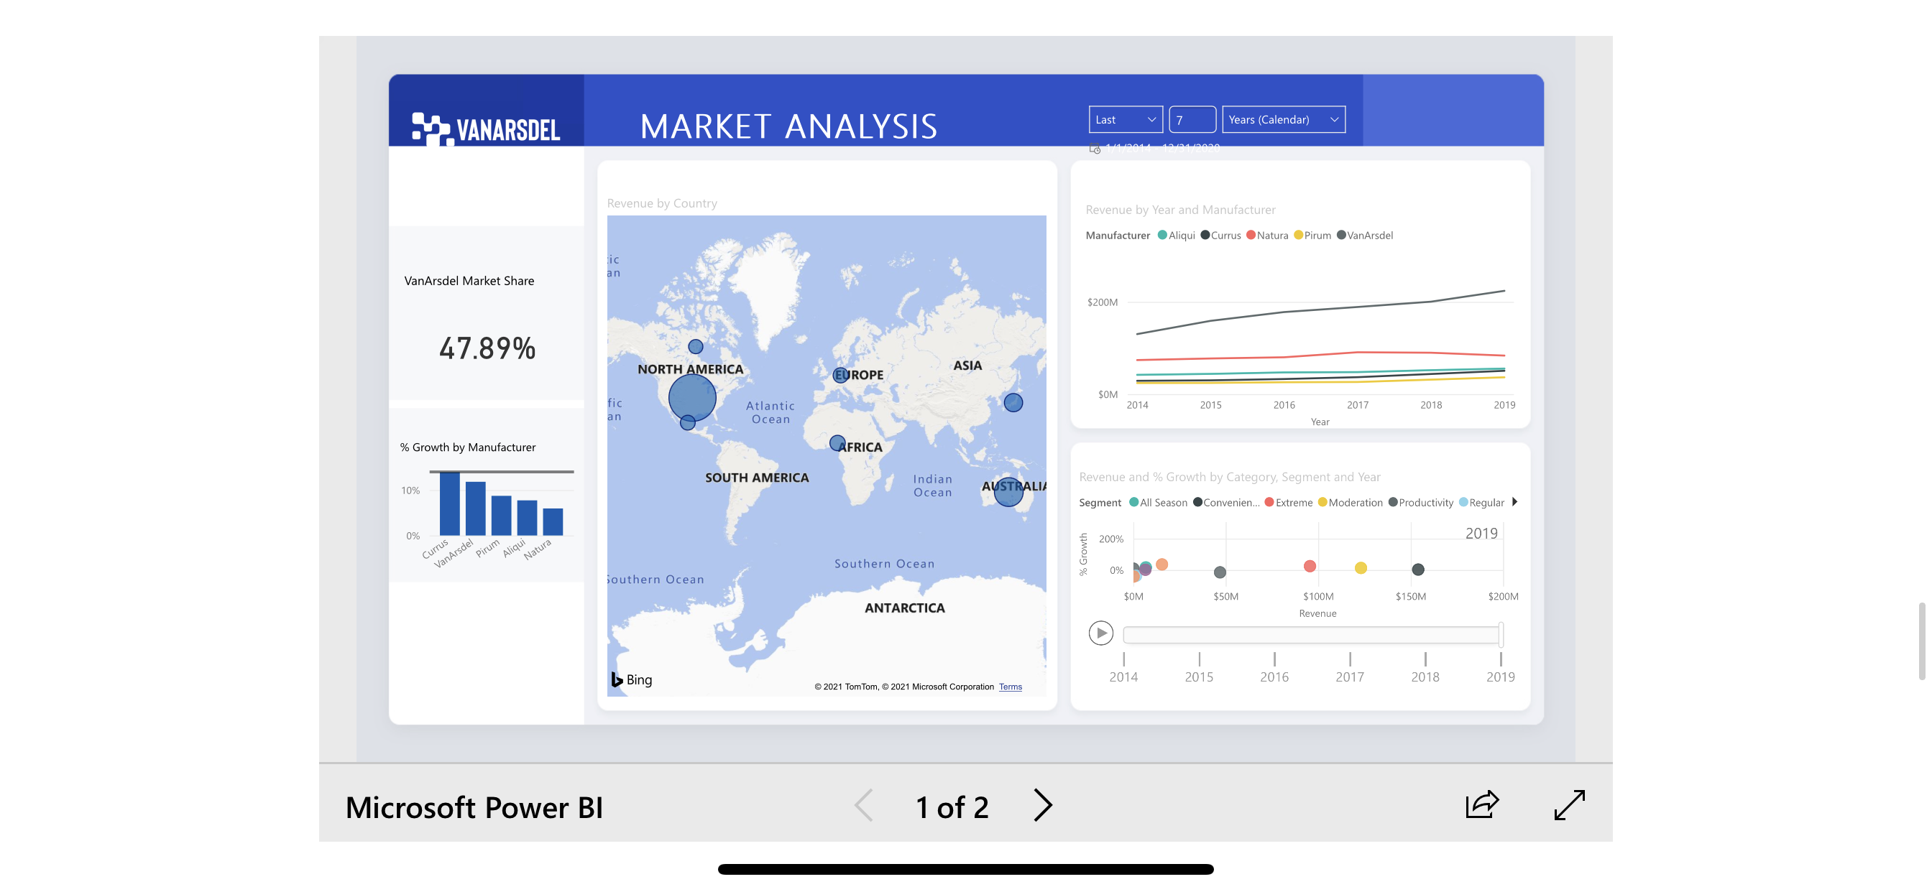
What is RDA?
RDA is a public data science tool in a sense that it serves as a library for data analysis and reports for a variety of subjects
The intended reporting methods range from being as simple as basic charts to in-depth and fully interactive Microsoft Bi models as well as python-generated visuals and statistics (currently in beta)

Slide 3
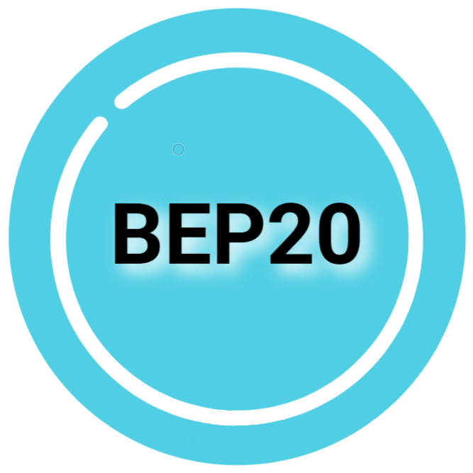


Special Features
Support and promotion for multiple data science contributors.
RDA is currently undergoing a retrofitting of-sorts to enable users to create a free, personalized account that will enable them to partake in custom-made surveys (programmed in python in conjunction with SQLAlchemy) to cultivate organic data from within the application which will pay users in the applications’ native cryptocurrency, BEP20 Token.
BEP20 Token (https://bep20.dev) is a subsidiary project developed alongside RDA which is a cybersecurity oriented crypto project launched on the Binance Smart Chain
After full functionality of user accounts, surveys, and automatic participation-triggered cryptopayments, the website will be wrapped into the React Native framework to allow it to function as a stand-alone app and offered on the iOS, Android app store and Google Play

Slide 4
App Diagram
User Website
New User
Input
Landing Page
New User
Reports, News, Etc.
Log In
Surveys
New User input checked for pre-existence in DB (Boolean)
IF TRUE : internal error thrown, user prompted to try again or reset password with email
IF FALSE : Unique private key/public key/address generated for user BEP20 wallet
Input and Wallet data are synced to DB
Redirect to Login
Login checked against database and then redirect to User Site
Survey answers are linked to each user by their profile, synced to DB, then cryptopayment is initiated
User Database
Cryptopayment
User BEP20 Wallet
Cloud hosted @ DigitalOcean.com

Slide 5
Development Workflow
Completion estimate: 45.83%
Create/publish RealData.app website
Generate basic categories/reports
Create BEP20 Token/launch on BSC Mainnet & publish separate website
Create User Database
Reformat Landing Page for website to point to a User Login
Beef up server-side security
Write python-programmed surveys and link from action button within User website
Create secondary Solidity smart contract for event-triggered payments to uniquely identified users
Add secondary content features (News feed through aggregated sources)
Port website into ReactNative framware
Apply for Apple credentials/release on Android app store and Google Play
After confirmation, release onto iOS app store
= Completed
= Partially completed/beta testing

Slide 6
Potential Technical Changes
Because of the way that solidity smart contracts operate, trying to get an outside python script to communicate with the internal functions of a smart contract could be difficult or problematic. The proposed workaround to this, should that be the case, is to give the python script full autonomous control over a particular address via API available through Binance Smart Chains’ native block explorer (https://www.BSCscan.com)
Since the survey function is an added layer of functionality, the scripts and their respective databases will most likely be hosted separate from the cloud that the user database exists (and activated via internal controls) in order to keep the data separated and mitigate any possibility that the script could be hijacked as a backdoor to gain access to users account information. Python scripts can present the possibility of a security risk. As an added layer of security, I am currently testing integration of the Google Authenticator application as well as 2FA through phone number.

Slide 7
Expectations for next presentation 6/11/2021
By next Friday, I intend to have the website pointed to a new landing page that requires users to login or create an account. This will be the beginning of the functional life of the Cloud-hosted User database as well as where the first layers of security are implemented.
Additionally, there will be additional report uploads & possibly new categories.
Secondary goal: Complete the development of the survey-function to prep for integration and next steps

Slide 8
Check out my progress along the way and please feel free to criticize or give feedback by going to
https://www.RealData.app

